Slide 1

THE FOUNDATION

Slide 2
WEEK 2 OVERVIEW
This week examines the information marketers need before selecting digital tactics. The lessons connect brand decisions with customer research and campaign goals.

Slide 3
WEEK 2 ROADMAP
SECTION 1: THE FOUNDATION
Brand, customer, and goals
SECTION 2: THE BRAND
Mission, positioning, identity, and image
SECTION 3: THE CUSTOMER
Buyer personas, journeys, and touchpoints
SECTION 4: CAMPAIGN GOALS
The outcome the campaign should achieve

Slide 4
SECTION 1: THE FOUNDATION
Brand, customer, and goals form the base of the strategy.

Slide 5
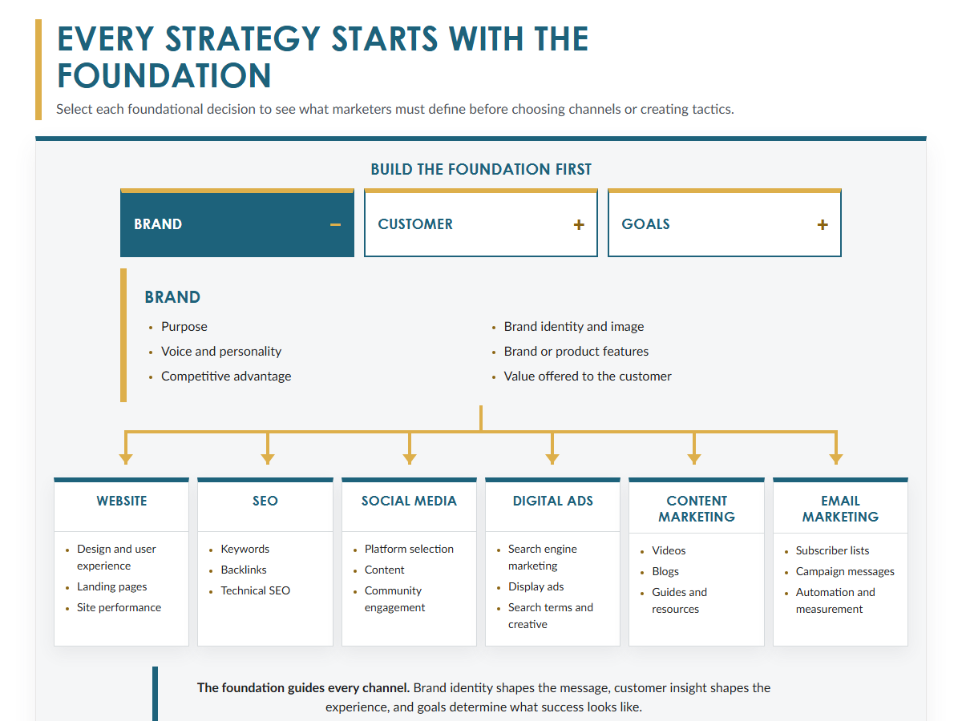
FOUNDATION
Before choosing tactics, define what the organization stands for, who the customer is, and what the campaign must accomplish.

Slide 6
THE FOUNDATION GUIDES EVERY CHANNEL
Brand clarity shapes the message.
Customer insight shapes the experience.
Campaign goals define what success looks like.

Slide 7
SECTION 2: THE BRAND
Mission, positioning, and identity clarify what the brand represents.

Slide 8
MISSION STATEMENT
The mission explains why the organization exists and what it seeks to contribute. It guides content, messages, and business decisions.

Slide 9
POSITIONING STATEMENT
For [target audience], [product or service] is [concise description]. It is ideal for [best use or application] because [primary benefit or differentiation].

Slide 10
UNIQUE SELLING PROPOSITION
A unique selling proposition states the benefit that sets the product apart in language the customer understands.

Slide 11
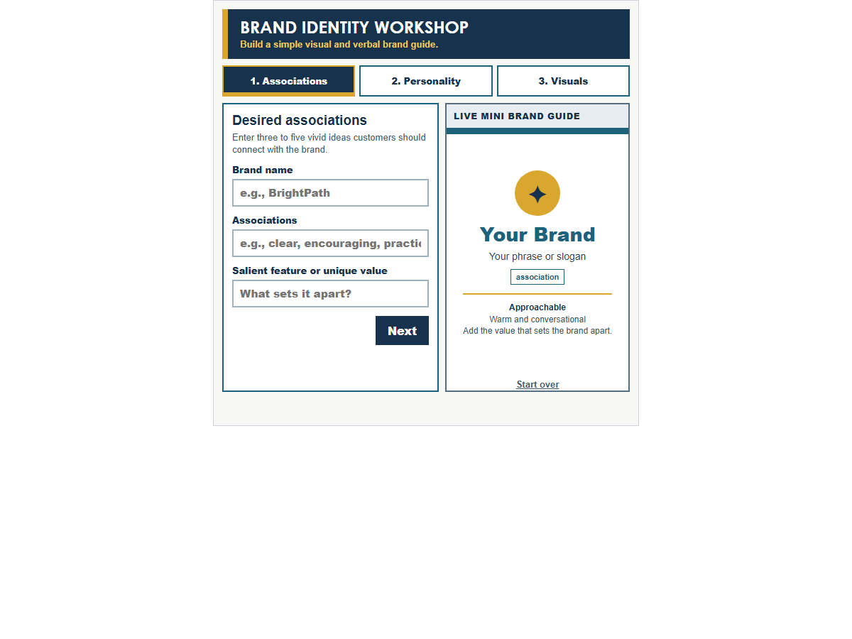
BRAND IDENTITY
Brand identity describes what the company creates and communicates.
Brand image reflects what people actually think and believe.

Slide 12
SECTION 3: THE CUSTOMER
Research defines the customer and maps the path to purchase.

Slide 13
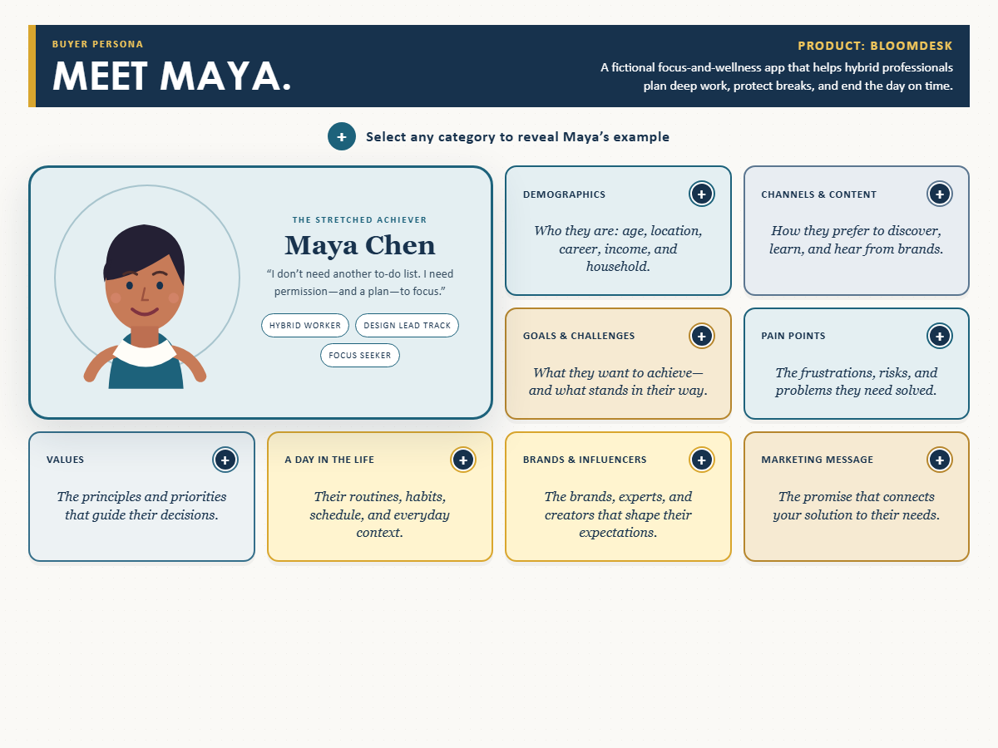
BUYER PERSONA
A buyer persona combines target-market research into a vivid picture of the ideal customer. It includes needs, pain points, objections, habits, and media behavior.

Slide 14
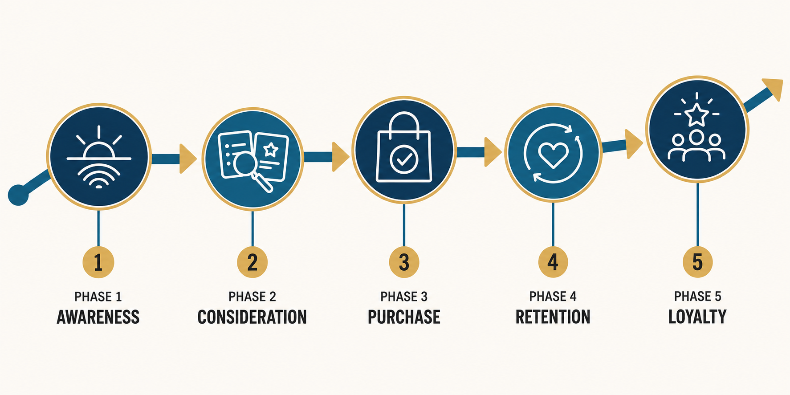
CUSTOMER JOURNEY

Slide 15
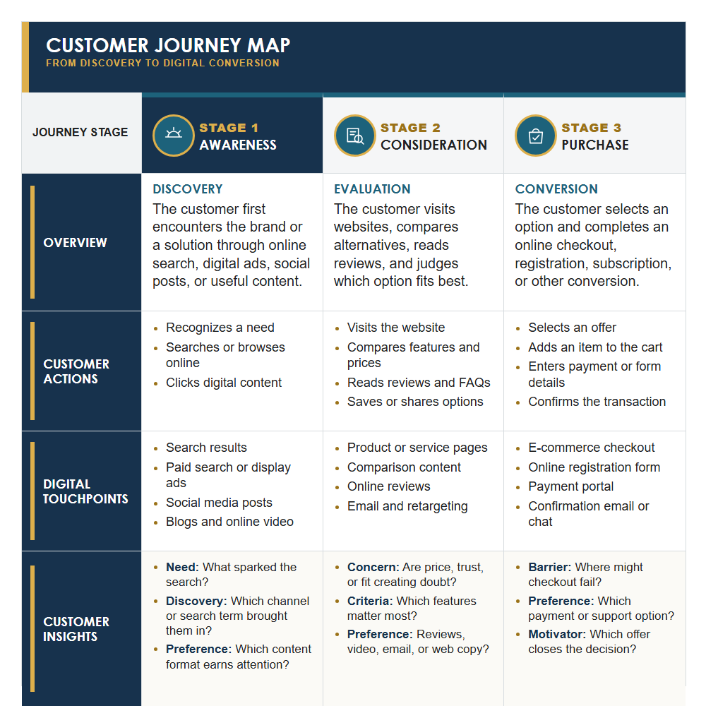
CUSTOMER JOURNEY MAP

Slide 16
SECTION 4: CAMPAIGN GOALS
The desired outcome determines the strategy and tactics.

Slide 17
DIGITAL MARKETING CAMPAIGN GOALS
Common goals include awareness and recall.
Other campaigns focus on sales, traffic, leads, positioning, credibility, relationships, or communicating value.
The right goal depends on the organization, audience, market, and product life-cycle stage.

Slide 18
THE FOUNDATION
Brand clarity, customer insight, and the right campaign goal guide every channel and tactic.

Slide 19
KEY TAKEAWAYS
Foundation decisions come before channel decisions.
Brand clarity shapes the message customers receive.
Customer insight and campaign goals guide the choice of tactics.

Slide 20
KEY TAKEAWAYS
A mission statement explains why the organization exists.
Positioning identifies the audience, product, context, and primary benefit.
A unique selling proposition states why a customer should choose the product.

Slide 21
KEY TAKEAWAYS
A buyer persona turns research into a clear picture of the ideal customer.
The customer journey traces what people do and need at each stage.
Touchpoints show where customers encounter information and make decisions.

Slide 22
KEY TAKEAWAYS
The campaign goal defines the outcome the strategy must produce.
Goals may focus on awareness, traffic, leads, sales, or customer relationships.
The organization, audience, market, and product stage determine the right goal.

